Slide 1




VIKAS.B
The Role of Communication
Clear Words. Strong impression .

Slide 2

Introduction
Communication is one of the most essential tools for any leader. It shapes how a team understands goals, handles challenges, and builds relationships. This presentation focuses on how effective communication can enhance leadership impact across all levels of an organization.

Slide 3

Why Communication Important ?
Good communication leads to employability.
Help others to be aware of all fields.
Good communication skill can build best team spirit to complete a task.
Being an inspiration to others , can build their own personality

Slide 4


Key Communication Skills
Volume and clarity
Showing understanding builds emotional connection.
Active Listening
Focus on the speaker . Seek to understand
Confidence
Reliable messages build trust and stability.
Adapting communication style
changing your tone, language, and approach depending on who you're speaking to.

Slide 5
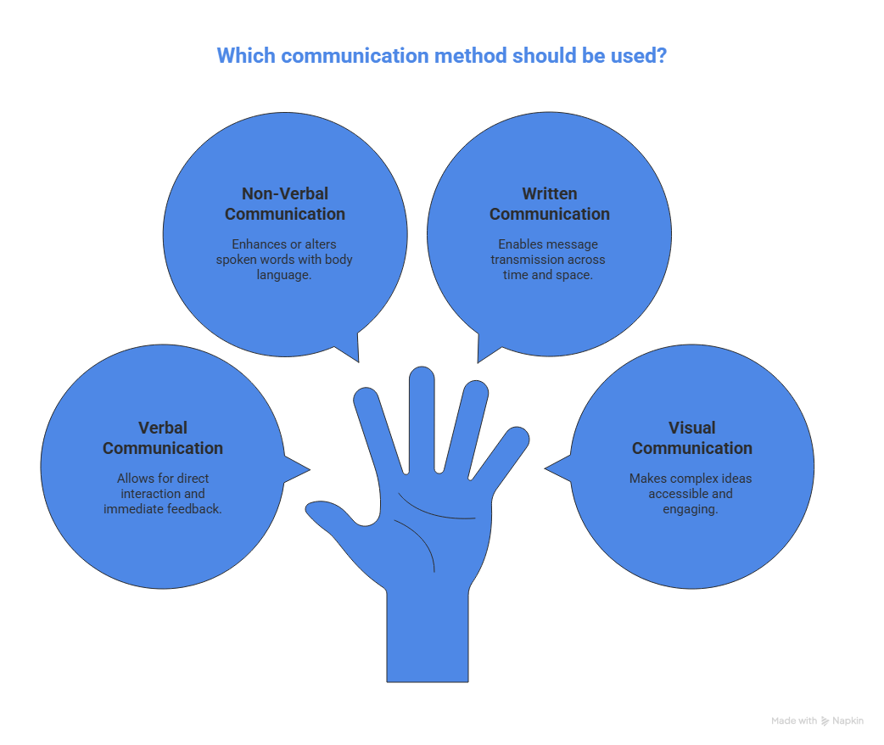

COMMUNICATION TYPES

Slide 6
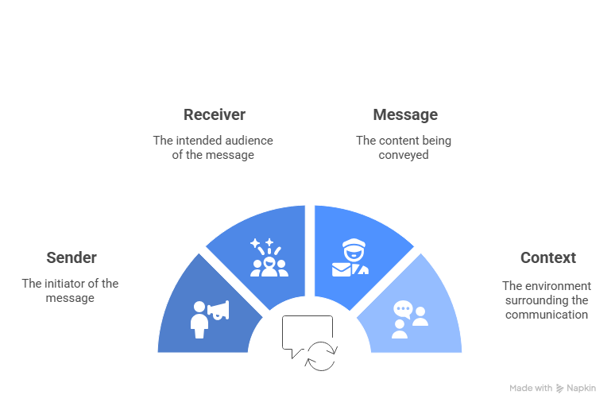
Basic Elements of Communication

Slide 7
VIKAS.B
Thank You
Speak with Meaningful Words. Connect with Purpose.

